Slide 1
THE BIG MAC INDEX
A Data Analytics Project

Slide 2





Team 6
Mereissa Henrie
Akeem Anderson
Drew Middleton
Daniel Gomez
Andrew Bullard

Slide 3
Purpose of the analysis
Understand economic disparities with hamburgers
Analyze currency valuation
Explore economic trends over the past few years

Slide 4
Data Overview
Date, Country, Currency Code, Local Price, Exchange Rate, Dollar Price, GDP-adjusted Price, etc.
Source: The Economist

Slide 5
Methodology
Data Collection
Data Cleaning
Data Analysis
Visualization

Slide 6
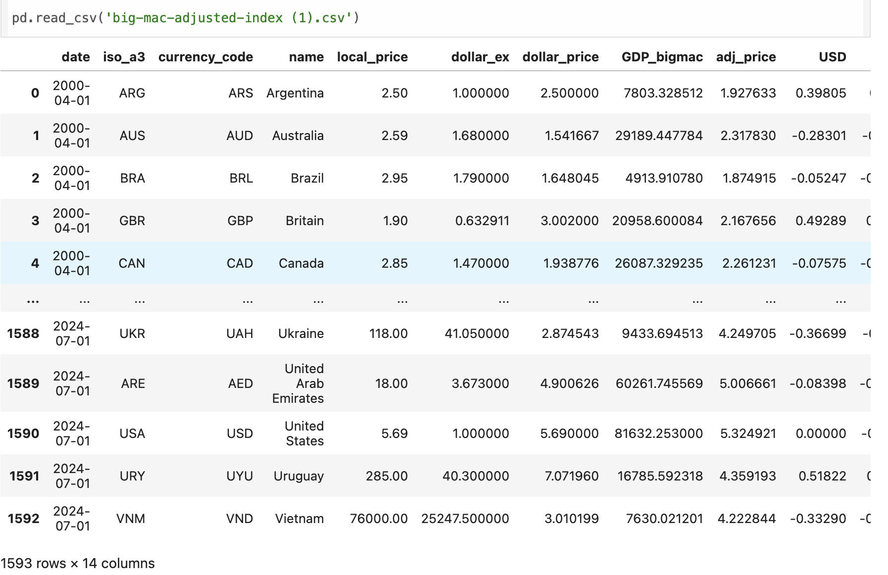
Data Cleaning
Handling missing values
Filtering countries
Standardizing data formats
Removing outliers

Slide 7
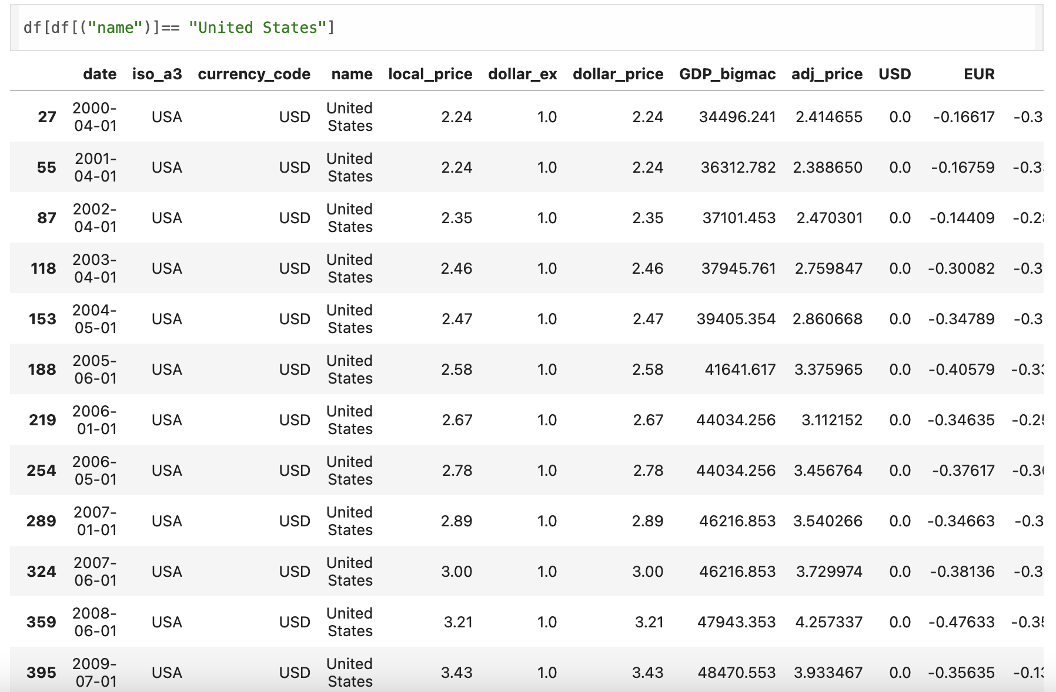
Data Cleaning

Slide 8
Data Analysis
Local Price vs. Dollar Price
Exchange Rate Impact
GDP-adjusted Price

Slide 9
Visualization
Bar charts comparing Big Mac prices over time
Line graphs showing ingredients trends over time
Scatter plots for GDP vs. Big Mac Price

Slide 10
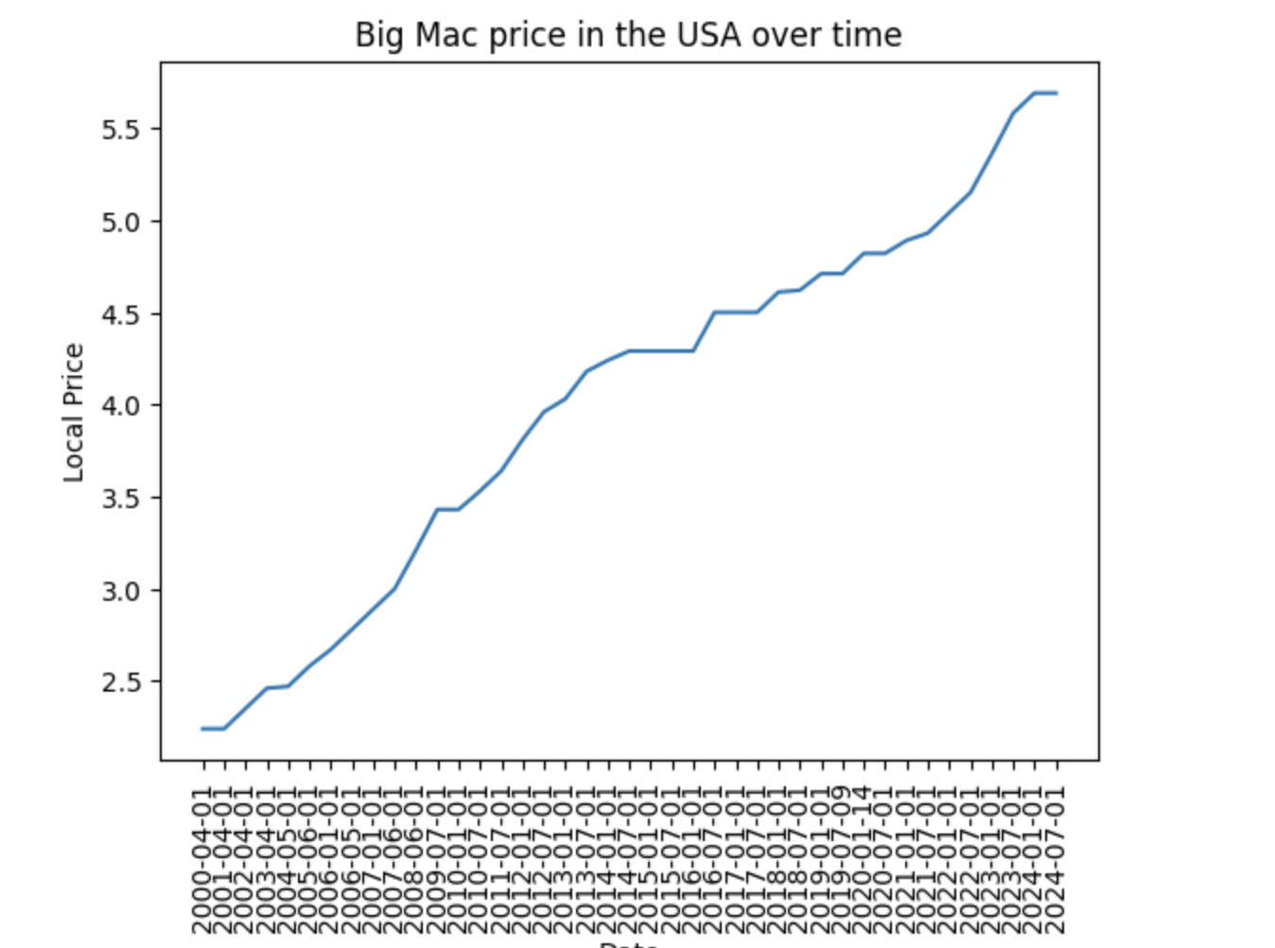
Big Mac Prices in USA over time (2000-2024)

Slide 11
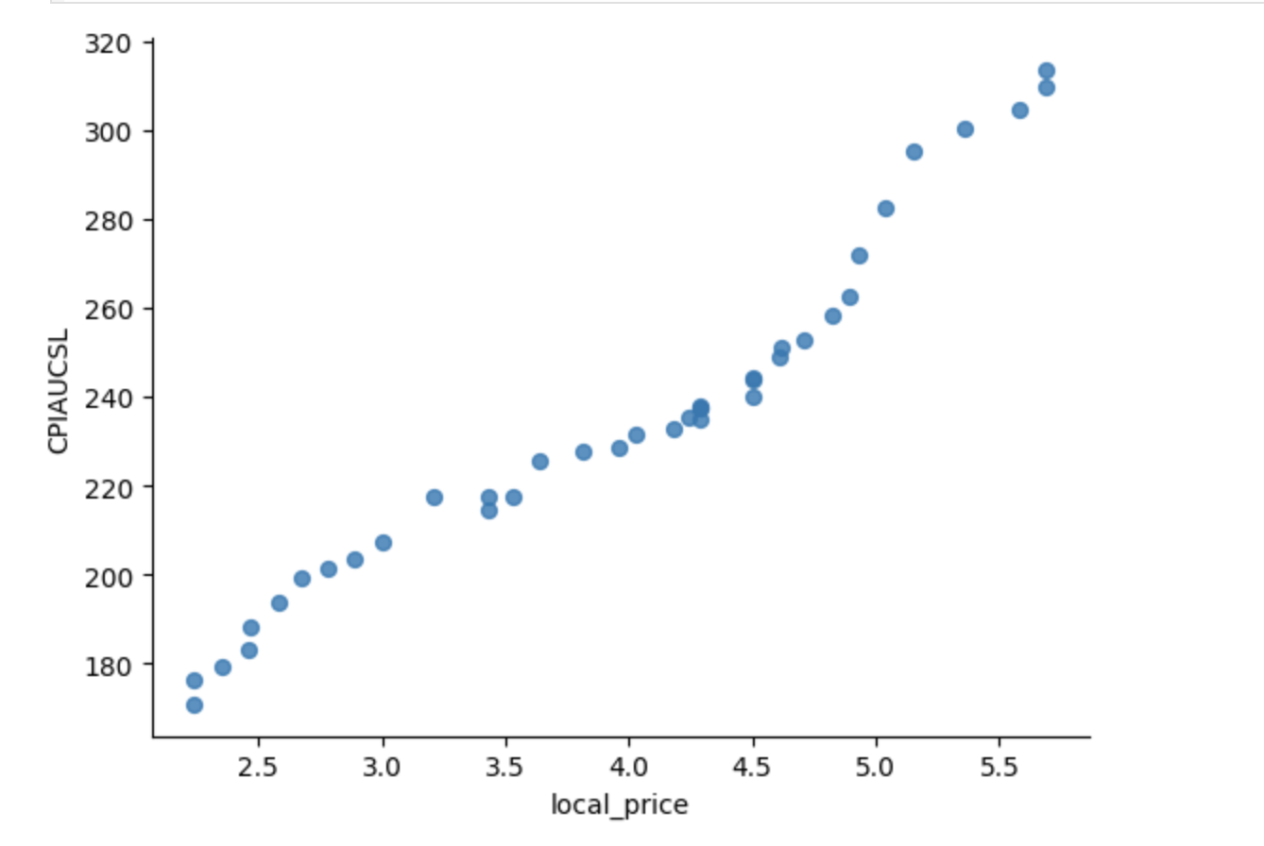
Local Price

Slide 12
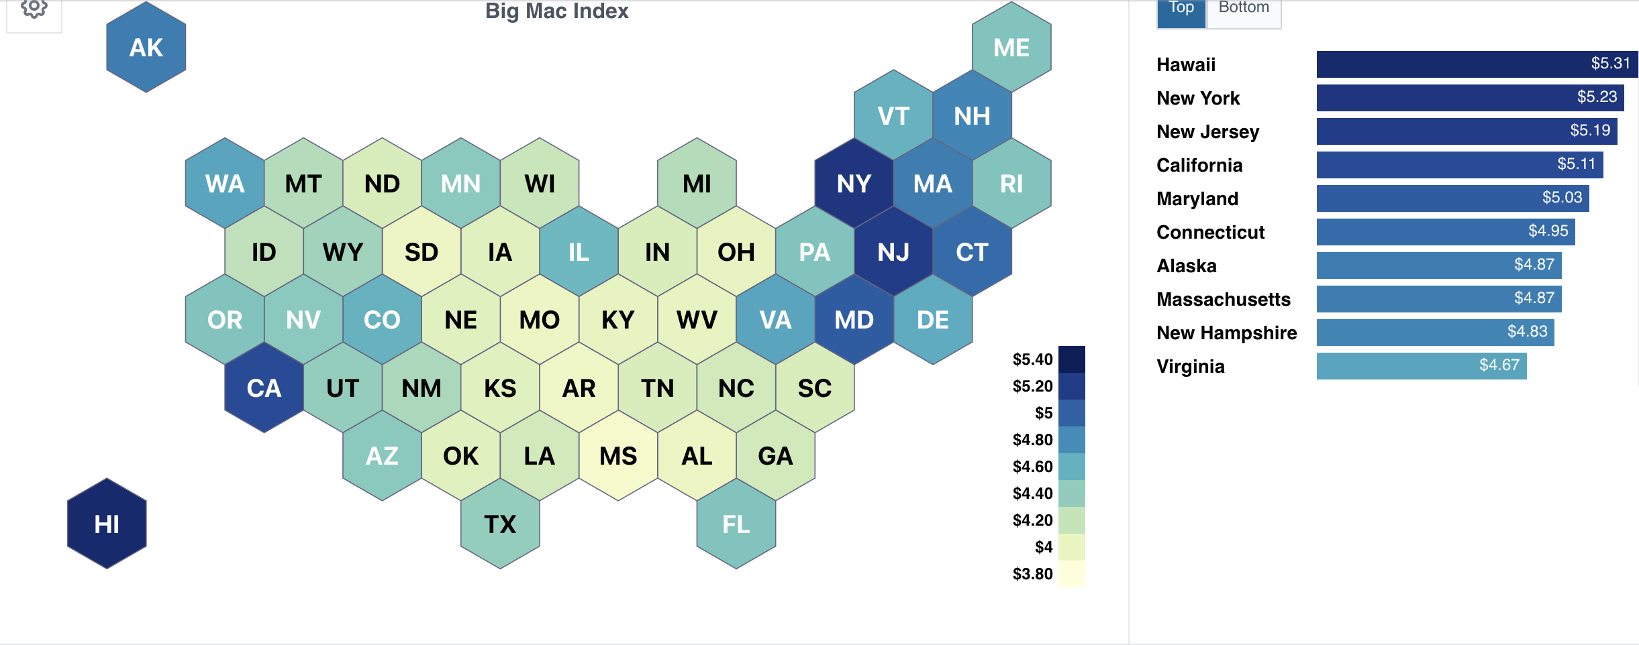
Price By State

Slide 13
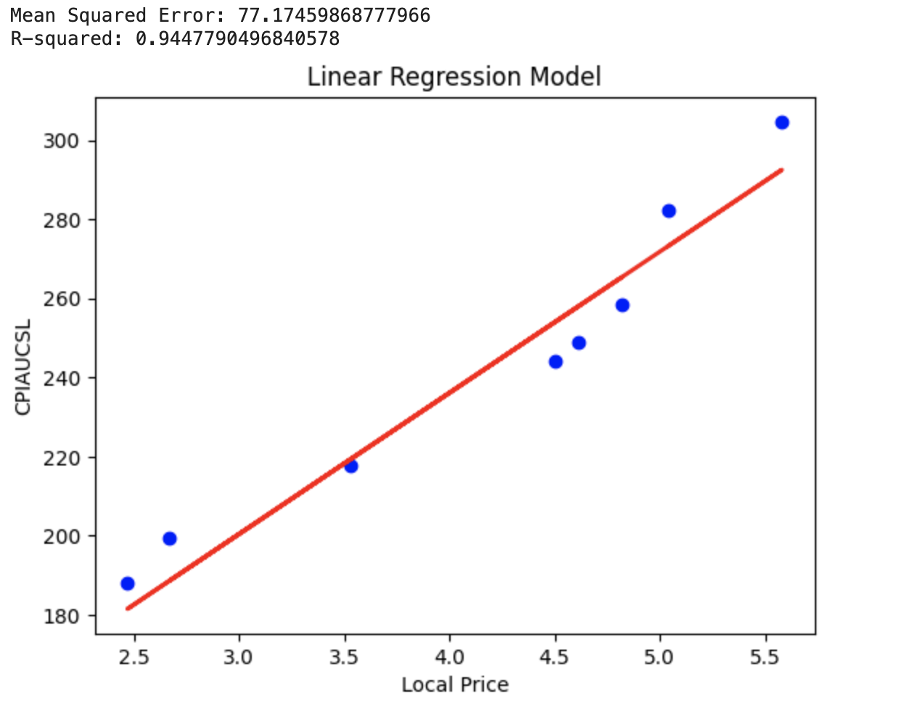
Linear Regression Model

Slide 14
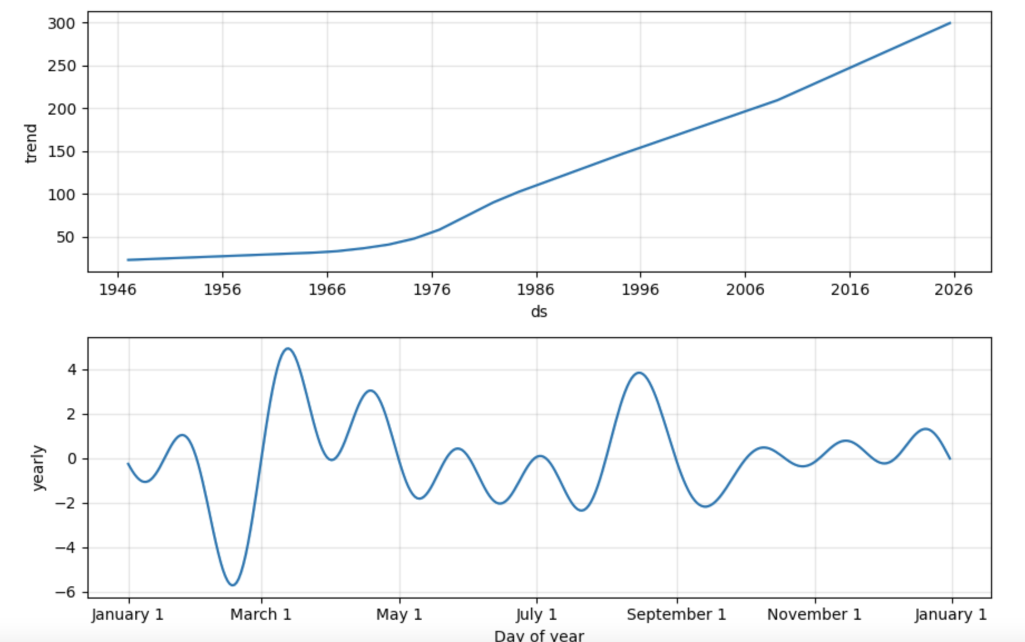
Trend Over Time Vs Annually

Slide 15
SQL Learning
Performed a comprehensive analysis of the Big Mac Index data using Apache Spark
Converted Spark DataFrames into Pandas DataFrames
Evaluated the model using Mean Squared Error (MSE) and R-squared metrics
Prophet library to perform time series forecasting on CPI data

Slide 16
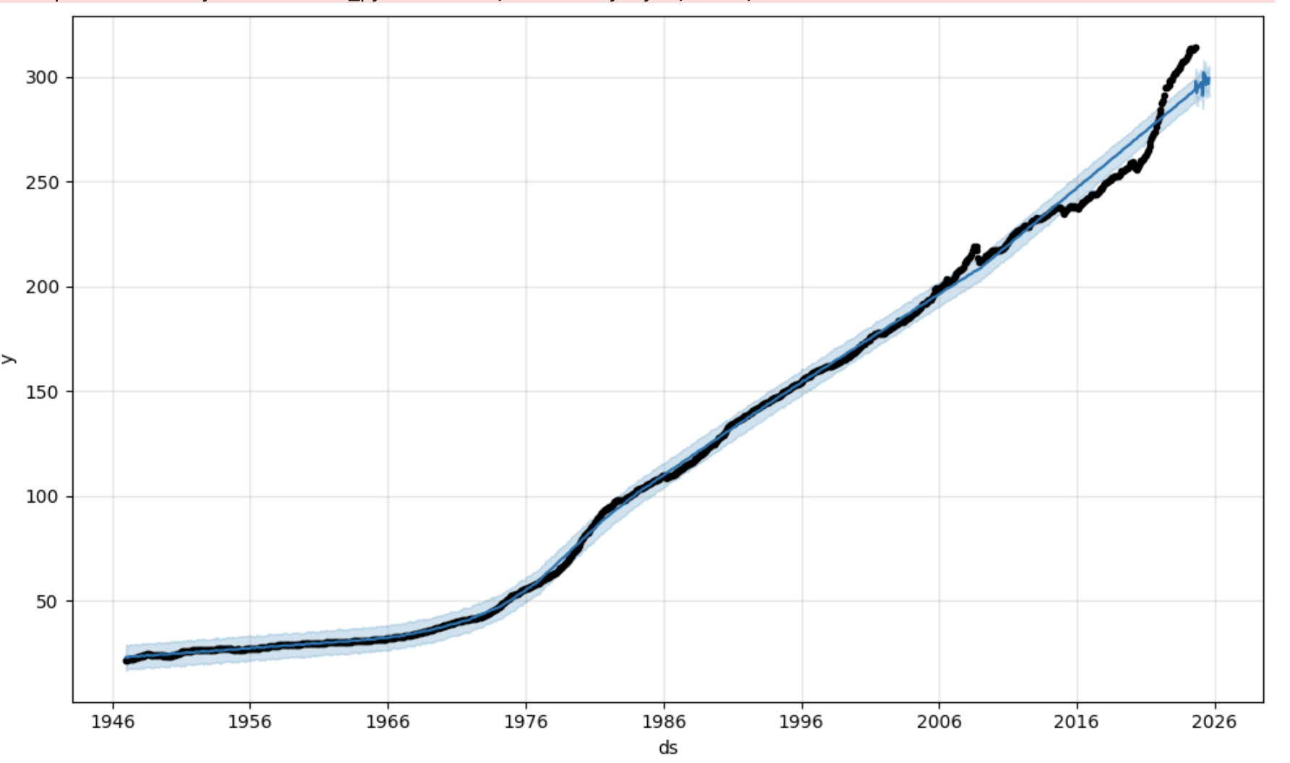
Projections

Slide 17

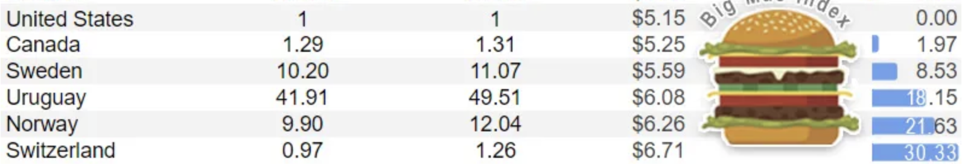
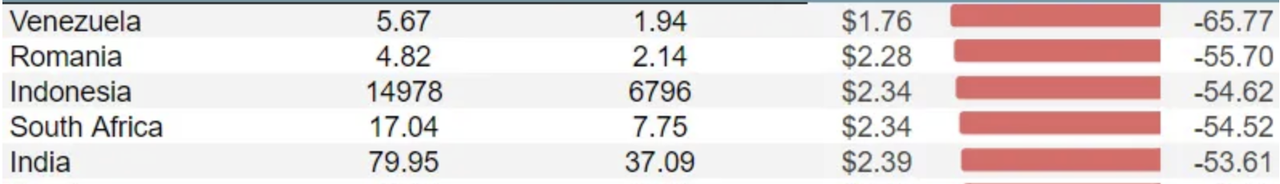
Country Comparison

Slide 18
Conclusion
Price Trends
Currency Valuation
Economic indicators

Slide 19
QUESTIONS?

